Slide 1
12-factor apps in .NET
Building apps for the cloud

Slide 2
Who are you?
Software Developer for 20 years
Worked mainly for ISVs
Reuters, SunGard, Misys, Huddle
Worked for a couple of MIS departments
DTI, Beazley
Microsoft MVP for C#
Interested in OO, SOA, EDA,, Messaging, REST
Interested in Agile methodologies and practices
No smart guys
Just the guys in this room

Slide 3
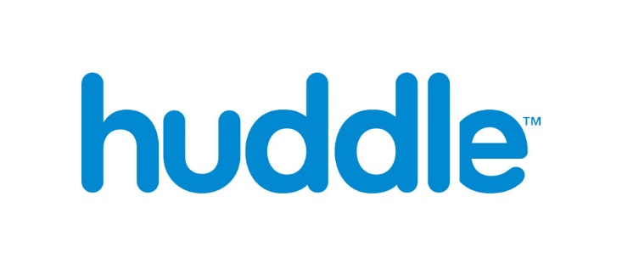
Intelligent collaboration for the Enterprise

Slide 4
Agenda
Origins
Goals
Design Factors
(Port Binding; Backing Services; Processes & Concurrency; Disposability)
Build and Release Factors
(Codebase; Dependencies; Config; Build, Release, Run)
Manage Factors
(Dev/Prod Parity; Logs; Admin Processes)

Slide 5
Housekeeping
Raise your hand if you can’t read the codes of the slides
For simplicity, you can download the slides from
https://github.com/iancooper/Presentations
And you can download the code from
https://github.com/Arc-Lightning/FutureStack
Which should help from the back of the room.

Slide 6
Origins
Credit where it is due

Slide 7
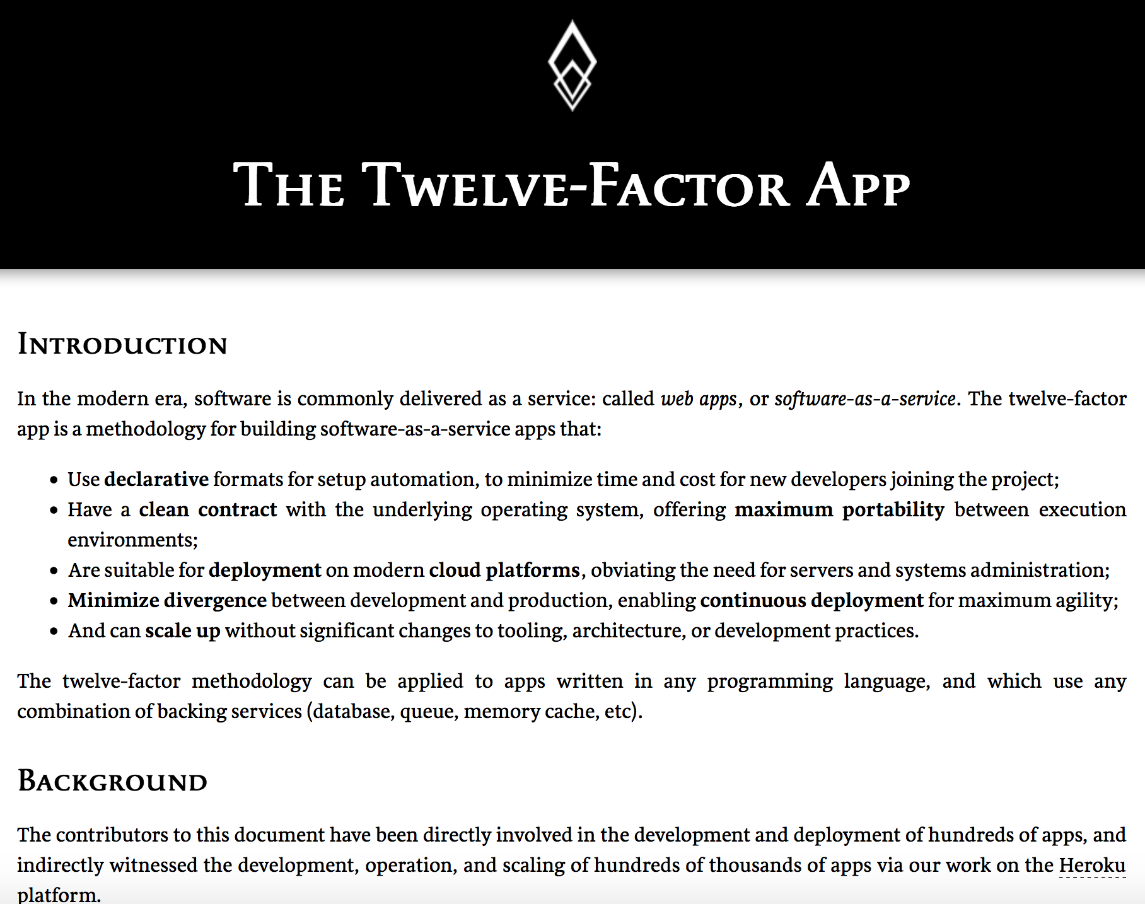
The Twelve Factor App
Created by contributors to the Heroku platform (particularly the co-founder Adam Wiggins):
Heroku is a Polyglot PAAS platform
The team derived the guidelines from their experience of what made app successful on Heroku.

Slide 8
“Use declarative formats for setup automation, to minimize time and cost for new developers joining the project”
https://12factor.net/
Notes:
The ‘ten-minute build’ rule should apply to your app, it should take less than 10 mins to grab all the required dependencies, build and deploy the app. There should be no ‘special machines’ here. It should be as easy to deploy locally as to deploy to the production server.
There is nothing worse than a painful onboarding scenario for new developers on the team that requires them to spend hours configuring the machine to run the app (or for devs on another team who need your app as a dependency to become mire in deploying your app to their environment).

Slide 9
“Have a clean contract with the underlying operating system, offering maximum portability between execution environments”
https://12factor.net/
Notes:
Wiggins identifies software rot as a particular problem that 12-factor apps try to address.
There are two forms of software rot that we care about:
Software changes that result in ’death by a thousand cuts’. Refactoring is the solution to this problem, and is not the subject for 12-factor apps
Environment changes that result in our software failing to run as expected any more.
The question is: why do environment changes cause software to deteriorate after a period of time, during which no changes are made to the codebase.
Some typical issues:
The OS needs updating to fix security issues and/or bugs. Following those updates the application no longer works unless we update our dependencies i.e. libs no longer work on new version of platform
OS is end-of life and we need to move to an instance on a new server with a newer OS and the application no longer works without updating dependencies
We are forced to update dependencies, but they no longer exist or are maintained
We need to move a resource that the application depends on, for example a URI, but this location is hard-coded in the app.
We need to change the account used to access alternative services, i.e. a new account name, a change of password etc.
We run out of resources on the host: disk space, memory, bandwidth either due to a failure to manage those resources inefficiently or capacity planning not accounting for actual growth.

Slide 10
“Are suitable for deployment on modern cloud platforms, obviating the need for servers and systems administration”
https://12factor.net/
Notes:
The cloud is not just about IAAS, it also includes deployment targets like PAAS and Serverless (AWS Lambda or Azure Functions). In addition, Docker has changed the way we may choose to deploy, providing an isolated sandbox to deploy to within a server environment, which means that an application shares kernel resources
How do we architect an application that meets the limitations/requirements of those platforms?
We want to try to remove the need to install anything other than our code, a runtime, and any packages we need on those platforms. In many cases, PAAS or Serverless, we don’t actually have access to the underlying platform to modify it.
We want to avoid the need for housekeeping caused by our app: deleting log files that are filling up hard disk space, breaking our app because we need to upgrade the server etc. PAAS and Severless remove many of these issues at source, but only if we can run in those environments.

Slide 11
“Minimize divergence between development and production, enabling continuous deployment for maximum agility”
https://12factor.net/
Notes:
Part of this constraint is that the **local** deployment should the same configuration as **other environments** i.e. same Db, same middleware etc. Differences between these factors are a key cause of unexpected pain in deployment or ‘failure in production’.

Slide 12
“Can scale up without significant changes to tooling, architecture, or development practices.”
https://12factor.net/
Notes:
We want our approach to provide scalability, without necessarily needing significant re-architecture. Though there are some constraints here, we may only be able to defer that point without incurring excessive cost to build scalability in from the outset, then one goal is to try and make horizontal scaling a usable default, because vertical scaling often requires us to re-architect faster than horizontal scaling.

Slide 13
Design
The factors that impact how we design applications for the cloud

Slide 14
Port Binding

Slide 15
12-factor apps
“Export services via port binding”
Your app should bind to a port, and receive requests via that port, or return responses
The App should be self-hosted
It should spin up, and start listening on a port, or start talking to one
Apps talk to one another by exposing an address
A web app tends to listen to HTTP, but a backing service might listen to AMQP where the ’port’ is a URL to the server, etc.
Avoid hosting in an application server, like IIS
Notes:
There is a problem with hosting in IIS when we think about modern elastic scenarios.
I want to be able to spin up a reverse proxy and have that route traffic to two or more apps for HA and scaling needs. The apps themselves don’t need to provide a lot of the functionality of a web server i.e. serving static files, https negotiation etc. They just need to expose a port so that requests can be routed to them. I can do this easily with something like Nginx or HAProxy talking to an app that exposes a port, using separate instances to deploy to.
This all becomes a little harder with an application container like IIS, as each app would have to be deployed into an IIS web farm, with many apps deployed into the same container, separated by ports and using DNS for resolution. This doesn’t play well with PAAS scenarios or container scenarios as in the former case the provider should be doing this work for us, and in the latter case we want isolation of an app per container

Slide 16
Backing Services

Slide 17
12-factor apps
“Treat Backing Services as Attached Resources”
A backing service is any app or service that the app consumes
A 12-factor app treats each distinct backing service as an attached resource
Resources can be attached/detached at will
Without redeploying the application
Notes:
A ’Backing Service’ is another app that your app depends on:
A ‘backing store’, for example SQL Server or Redis is a ‘backing service.
Middleware, such as RabbitMQ or 0MQ is a backing service.
Services such as SMTP
Another app under your control that you talk to via REST is a ’backing service’
A third-party app that you talk to is a ‘backing service’ (including your New Relic etc. AMS tool, your use of S3 for storage etc.)
A 12-factor app considers these all to be resources and makes no distinction between a local and a remote resource
There are two main issues for backing services that the 12-factor app manifesto tries to deal with:
The location of the resource may change
Between development, staging, and production we might move between locally hosted to hosted by a third-party
An administrator may wish to change the location of the resource (to replace a faulty instance, modify an instance, or scale up)
Code should never depend on the location of these resources. So we need to either:
Use config to locate a resource
Use Service Discovery to locate a resource

Slide 18
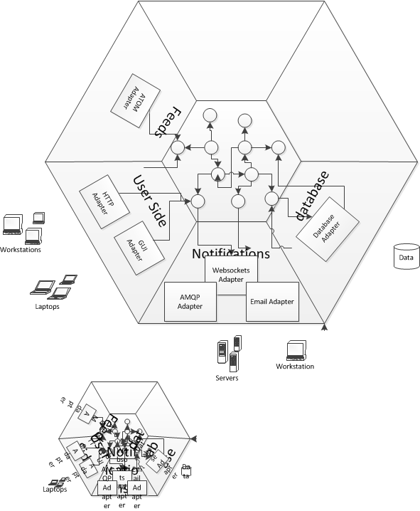
Ian says
Use a Ports and Adapters architecture
Separate the domain model from I/O
Ports mediate between the two
Primary adapters (left) are inputs
Secondary adapters (right) we exercise
Secondary adapters are backing services
Notes:
A ports & adapters architectural style (Hexagonal Architecture) is a variation of the layered architectural style which makes clear the separation between the domain model - which contains the rules of our application - and the adapters, which abstract the inputs to the system and our outputs.
The advantage of this style is that the application is decoupled from the nature of the input or output device, and any frameworks used to implement them. We have a notion of primary and secondary actors in use cases which map to the adapter and port layer.
Primary actors exercise our application, they are inputs into our application.
A primary actor uses a primary adapter, which calls a primary port - the chain is one of inputs into our application. So our REST API is a primary adapter, so are our tests.
A secondary actor is one that our application exercises as part of its work, they are outputs from out application.
So our DB is a secondary adapter, as our mocks and we talk to them over a secondary port.
Many applications seem to consist only of one primary and one secondary, which leads to the n-tier style, but once we factor in tests we may begin to observe that we have more, and by building for multiple ports we make our application more modifiable to new ports in future.
We often show primary ports on the left and secondary ports on the right.

Slide 19
Ian says
Strongly consider using service location
Environment variable changes may require a restart
Environment variables become difficult to manage in complex topologies.
Too many machines.
Too long to update configs and restart machines
Use a distributed key-value store to hold server locations
Consul, Zookeeper, etc.
Favor automatic registration of containers with the store

Slide 20
Processes and Concurrency

Slide 21
12-factor apps
“Execute the app as one or more stateless processes”
The first key idea here is that your app should be stateless
No sticky sessions, store user’s state in your backing store
Reload your state if required to service subsequent requests
The memory space or filesystem of the process can be used as a brief, single-transaction cache.
Notes:
Sticky sessions hammer your ability to scale. Simply put you can’t move traffic between servers in your web farm. This causes two problems:
If the server the user’s request goes to comes under load (perhaps a noisy neighbor) you cannot move subsequent requests to a more performant server
If you need to take down a server for maintenance purposes then you have to kill any users who were using that server.
“The memory space or filesystem of the process can be used as a brief, single-transaction cache.” What does this mean. It means that we should make no assumptions about the persistence of memory on a server or the filesystem of a server beyond the request-response lifecycle. Any subsequent request will have to load the item again as it may be a different process running on a different machine.

Slide 22
12-factor apps
“Scale out via the process model”
Prefer to scale out, using new instances of the process
Use separate processes for different workloads
So HTTP workloads via a web process
Long-running background tasks by a worker process
As a process is ‘share-nothing’
We can introduce greater capacity by introducing new processes
Don’t demonize use the operating system’s process manager
Notes:
Nothing in the 12-factor app manifesto says you cannot vertically scale.
So it is permissible for a 12-factor app to multiplex via threads in the runtime (and indeed some runtimes are expensive to create so this model should be used), or to use asynchronous/evented reactor models to increase throughput when performing IO etc.
But vertical scaling becomes prohibitively expensive at a certain point and does not aid with availability
We don’t demonize because this implies access to low-level OS services which risks software erosion and may not be available on all platforms we deploy to. Instead we should rely on a process manager to provide our runtime management needs. (Note that this implies we should move away from Windows Service deployments as these demonize the console application and use Task Scheduler instead).

Slide 23
Ian says
“Use backing services if you need to cache expensive items”
Use a distributed key-value store as cache for example as opposed to process memory
e.g. Redis, memcached
Use shared storage, such as an EBS volume or S3 as opposed to local storage on the server, allowing all processes to access
Notes:
The pain point is anything that is ‘process’ or ‘machine’ local. You can still cache expensive to create items, but you do not want to do so in a way that creates process affinity.
By treating them as a backing service we benefit from the idea that they are an attachable and swappable resource

Slide 24
Disposability

Slide 25
12-factor apps
“Maximize robustness with fast startup and graceful shutdown”
A process should be able to start and stop at a moment’s notice
Start in a few seconds
Stop Gracefully
Elastic Scaling
Rapid deployment of code or config changes
Easy server maintenance including scheduling
Notes:
A quick start aids scheduling: we can bring capacity on stream rapidly when we need it. Monitor your startup times, use background workers if required to allow a responsive start to receive requests, and a queue for those requests to wait for resources to come on stream if they are expensive.
A graceful shutdown reassures administrators that they can safely terminate instances: the ideal would be:
Web process: finish any existing request, but refuse new requests. Assuming that a request can be completed in under 300ms or so, to allow shutdown to be fast
Worker process: either return work to the queue with a nack, or finish work before shutting down. The choice depends on how long work takes (fast jobs under 500ms could be allowed to finish), and the extent to which work is reentrant either by being transacted or idempotent so that it can be canceled and then re-run.
It is also important to consider what happens in the event of catastrophic failure i.e. hardware loss. The use of automatic rollback of transactions, messages to the queue, etc. after a timeout is helpful here as it prevents us failing in an ‘inconsistent’ state.

Slide 26
Todo-Backend
A demo of a 12-factor app

Slide 27
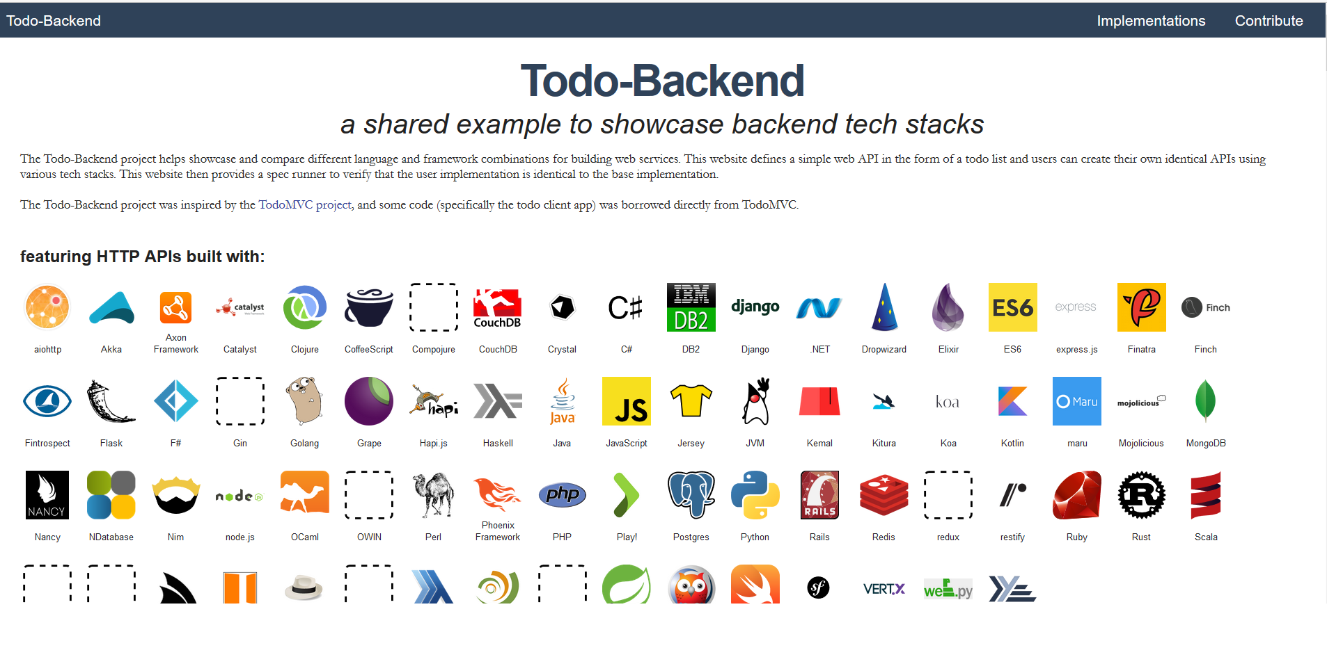

Slide 28
Demo
Notes:
-- Demo
Run the containers using docker-compose
Show the TodoBackend Tests running against the app
Show the client running against the app
Use Fiddler for a Bulk upload
Show the worker logs
--Walkthrough
Navigate to the startup and show we use kestrel to self-host
Note use of Nginx as a reverse proxy
Show a controller, with the primary adapter calling ports
Show a handler with the port calling a secondary adapter
Show the configuration of the secondary adapter
Show a service activator consumer
Show both configured as separate processes.
Show a Docker compose file for many instances
(Still don’t run it, wait for that stage of the talk)

Slide 29
Build & Release
The factors that impact how we deploy applications to the cloud

Slide 30
Codebase

Slide 31
12-factor apps
“One codebase tracked in revision control, many deploys”
The code repository or repo is a copy of the revision tracking control database
1 App == 1 repo
Multiple repos are a distributed system
Shared code must be managed via dependency manager, not shared source in repo
A deploy is a running instance of the app, using the same repo
Notes:
By one codebase per app, do we only mean codebase per process?
Take the example of a web and worker, that share the same model, but the worker uses the same domain model and Db and just handles the long-running workloads.
One or two repos? Some folks (Pivotal) say two because there is a smell that you may actually have two microservices.
The key issue is CI boundaries. Do you have one CI boundary i.e. build and test together? Then put it in the same repo (corollary with admin tools). This is a microservice boundary anyway i.e. a bounded context. Split the repo for separate microservices.
i.e. on app == one microservice == one repo

Slide 32
Demo Prep 1: Pulling the Code

Slide 33
Dependencies

Slide 34
12-factor apps
“Explicitly declare and isolate dependencies”
Requires the ecosystem to support a package manager
Requires the ability to isolate an app from other apps i.e. no shared dependencies
Examples include a gemfile or a requirements.txt file produced by Pip
Isolation includes something like Python’s virtualenv
We want to install the runtime and package manager only
clone, restore, build, run
git clone, dotnet restore, dotnet build, dotnet run is a good example of this

Slide 35
Pull, Restore, Build

Slide 36
Demo
Notes:
Open a new command prompt
Create a directory
Git clone https://github.com/Arc-Lightning/FutureStack repository
Review the Dockerfiles in Code
Point out that we grab a clean base image (use runtime only image, not SDK)
Point to the code where we restore the dependencies for the application
We may find that internet connection is poor and we don’t have dependencies
So you need to use the Dockerfile to ‘pre-bake’ an image with dependencies realized on the machine

Slide 37
12-factor apps
“Store config in the environment”
In this case configuration means anything that varies between deploys
A 12-factor app requires strict separation between config and code.
Config is not checked into the app’s repository.
It often contains secrets such as passwords, or topology dependent information
Because configuration varies by environment – store it in environment variables
Routing tables etc. are not considered configuration for this.
They can often be set in code
But even if you use config, it is not config between enviroments
Notes:
The smells here are:
Per-environment configuration files checked into source control
Templated configuration files checked into repos that must be merged with per-environment data files
Environment information hard-coded into source code (obviously)
You could still have a configuration file, particularly if your runtime requires it, to tell you how to run the software, provided it is information that does not vary by deploy. Prefer code for many of these settings if possible, especially if you would be likely to re-deploy as a result of any change i.e. routing changes probably mean that you have written a new handler so you would redeploy anyway.
But things that change at runtime, such as connection strings, no-of-threads, timeout values, urls of external services etc. should be stored in environment variables.
Why not just use a file and merge?
Complexity. It’s simpler just to grab from the os. You want an immutable release artefact, not an artefact that must be rebuilt for every environment that it is deployed to. Avoid rebuilding for different environments, instead rely on an immutable release artefact that does not vary
In PASS environments we may not have access to configuration files
In Container environments its simple to use a .env file to provide the environment information

Slide 38
Build, Release, Run

Slide 39
12-factor apps
“Strictly separate build and run stages”
The build stage converts the repo into an executable unit: a build
It uses a commit to the repo and fetches dependencies to create an asset
A release is a combination of a build and the config for a given environment
The run stage executes the app in a given environment
All these stages should be separate.
For example, no changes to deployed code, you have to alter the repo and build again
Notes:
This is fairly common nowadays: gone is the bad old era when people would hop onto the production server and manually edit the running configuration. The issues are numerous but the issue of ‘lost changes’ during the next build is particularly pernicious here.
Note that the environment is factored in at release. Broadly to change the environment should not involve a new build – the artefact becomes immutable, but may require restarting the app in order to load those environment changes.

Slide 40
Demo
Notes:
Open the application in Code
Show where we have configuration, and it is pulled from environment variables
Show where we have routing etc. in code
Edit the docker-compose file in Code
Production and Development environment equivalency
Build is done by a flag, we can build and then run

Slide 41
Manage
The factors that impact how we manage applications in the cloud

Slide 42
Logs and Admin
Keep development, staging, and production as similar as possible
Treat logs as event streams
Run admin/management tasks as one-off processes
Notes:
The time gap: A developer may work on code that takes days, weeks, or even months to go into production.
The personnel gap: Developers write code, ops engineers deploy it.
The tools gap: Developers may be using a stack like Nginx, SQLite, and OS X, while the production deploy uses Apache, MySQL, and Linux.
Backing services are one area where tooling often varies. There is a tendency to use something lightweight such as Redis over RabbitMQ in different environments, often because frameworks support easily switching between them. This creates different behaviors.
A log is a stream of time-ordered events produced by a running app or background service
A log has no beginning or end, but is continuous as long as the application is running
The app should not concern itself with the storage or routing of its stream
Log to stdout or stderr
Event stream can be viewed at the terminal
Have execution environment capture stream and route to storage
Use analysis tools to view logs

Slide 43
Summary

Slide 44
Summary
12-factor apps
One codebase tracked in revision control, many deploys
Explicitly declare and isolate dependencies
Store config in the environment
Treat backing services as attached resources
Strictly separate build and run stages
Execute the app as one or more stateless processes
Export services via port binding
Scale out via the process model
Maximize robustness with fast startup and graceful shutdown
Keep development, staging, and production as similar as possible
Treat logs as event streams
Run admin/management tasks as one-off processes

Slide 45
Q&A
Please share your feedback

